Slide 1
English For Computer
Session 3 Users
Session 4 – Current issues

Slide 2
Computer Applications and Users
A computer is a Programmable machine, tools or devices that processes data or facts to be an information
What data could be processed ?
  Any kind of data
In what area ?
  Almost all area
  A lot of application are developed to support business, industries, government, health etc
Computer has affected every aspect of modern life, that no part of the modern world that are not computer based

Slide 3
Applications
Computer technology has affected every aspect of modern life
Almost all areas are influenced by this technology that grows and develops rapidly every single day
Computer have numerous uses and applications
Among areas that need computer badly are business and industry, besides government, medical etc
Scientists, educators, professionals, researcher, engineer are need computer to complete their tasks
Computer technology has already changed people paradigm in managing their life

Slide 4
Computer in Business
The greatest effect of computer technology might be seen in the business area.
All business commonly uses electronic data processing, not only for daily activities like inventory, selling, billing, payroll, customer services, but they are also used for processing a complex operation such as budgeting, research and development, as well as planning.
Computer take a part in performing routine functions in the business through developing an application.
A computer is also used to handle many application, or in a big computer, the computer is also used in a sharing basis.
Banking is one of the business entity that rely and depends almost entirely upon the IT, to perform very complex operation, clearing, collection, accounting and reporting and delivering their service. They can not monitor all their delivery channels without any computer support
Computer is also used to develops control applications, such as company efficiency control, through the implementation of balance score card, robot for controlling operation, service leverage control, air traffic control, weather monitoring, earthquake report etc

Slide 5
Computer in Government
Government uses computer in record keeping functions such as taxes, maintaining social security data, census both social and population.
Some of the Government Bureau also depend on this device such as activity to monitor and report of the weather forcast, humidity, earthquake, volcano and tsunami detection report etc
The smooth operation of DOD need computers to coordinate activities among the various branches or the armed services, and computer technology is essential in the development of military weapons and complex defense systems.
Computer base analysis is needed in fighting criminals, indicate the areas of high crime incidence, as well as predicting future patterns of criminal activities.
Computers play a great role in controlling communication satellites, traffic control management and even traffic signals etc.

Slide 6
Computer in Science
Besides important in business and government, computers are also very important in scientific fields.
Geologists use computer technology to discover new deposits of energy resources, oceanographers use computers to obtain and process data concerning marine life, and botanist use computer-controlled instruments to analyze the composition of plants
Architects use computer to design houses
Space exploration would be impossible without computers, not only do computers control the operation of spacecraft, but also provide the data needed by astronauts to make their calculations

Slide 7
Computer in Health Care
Computers are used in the field of health care for various purposes :
  Maintaining accounts and other administrative duties are performed by computer
  Patients care functions are often done by using computer controlled kit
  Watch patients vital sign such as heart rate, blood pressure and temperature are conducted by using computer controlled kit .
Computers allow doctors and nurses have the opportunity to devote more time to individual patients.
Up to date medical information or status and history of the patients might be obtain immediately. Therefore, computers also help medical personnel by helping the make intelligent decision in life threatening situations
Live saving information can be obtained easily and immediately through database that be ready and available when is needed.

Slide 8
Computer in Education
In education, computers are not only used to keep student registration and further educational research, but also assist in educating the students
Student’s research must be efficient by using computer
Students have the ability to learn and find a lot of knowledge or education material through surfing in the internet
E-learning is impossible without any computer
IT School used computer as an tools for practice
And computer server large number of students individually

Slide 9
Computer in the Arts and Entertainment
Computers have equally important in to the art and entertainment just as proven to be beneficial to government, business and medicine
Computers support a great facility and capability to people who creative in developing or designing purposes.
Computers become very important tool in developing modern animation or cartoon and even in composing a song or recording music
Computers have also had a significant effect upon the entertainment field, as can be seen by the great popularity of computer games
The motion picture and television industries (broadcasting) also demonstrate the variety usage of computer.
The special effects which so popular in contemporary movies would be impossible without computer technology
The last of FIFA world cup with displaying soccer player’s statistics is never been there without computers

Slide 10
Computer at Home
With growing popularity of microcomputers, computer technology affects house living as well, even mobile
Providing computer at home, may either supplement for children’s education or to enrich their own knowledge.
Pre-school children take benefit from the use of home computers.
Especially with growing popularity of PC or laptop the use of computer become incredible. House wife plans menus, projecting budgets, balancing checkbook or saving herself.
On the other hands the usage of computer also derives effects, i.e.:
  Children often stay along the day in front of computer, sometime neglecting their tasks.
  House wife has forgotten her cooks for chatting with others.
  And there has been a divorce couple due to too much chatting

Slide 11
Summary
No part of the world that have not been affected by computer technology
People optimized computer to help completing their work in most all area
Computer might help people getting various knowledge to enhance their life
Computer is a tools…. So people should control computer usages themselves.

Slide 12
Issues in Data Processing
Besides the benefit, there are some issues that is generated from Computer Technology (computerization)
  Attitude Changing to the computers
  Computer is only a tools not a human being that can do everything
  Computer derives un-employments
  Computers and Privacy
  Computer Crime
  Computer robbery (CASHLESS-CHECKLESS)
  Problem involving software
  Computer piracy
  E-waste (Computer Pollution)
  Consumer’s Life Style
.Due to computers, our lives have changed very much, and will continue to change, but the understanding about computers and also the control should be taken care, to eliminate or at least to minimize issues.

Slide 13
Computer Piracy
One of the controversies in relation with software is that of computer piracy – the unlawful copying or duplication of software. It is currently common, especially in Indonesia, and often very easy for people to make copies of computer software instead of buying it.
The issue of pirating computer software is related to the problem of obtaining legal protection for computer programs. Such protection may be in the form of a copyright, a means to ensure that the author or creator of a specific item is given the exclusive legal right to that item.
It is very difficult to stop the pirating of computer software because many laws regarding the copyrighting of software are not clear. It is currently possible to copyright certain aspects of computer programs. However, the issue of proving ownership of the logic and basic structure of program is still unresolved.
Thus, while it is technically illegal to copy specific programs, it is impossible to stop others from copying or modifying its logic and structural composition.

Slide 14
Too much TV or computer’s games is bad, even for active children
More than two hours a day spent watching television or playing computer games could put a child at greater risk for psychological problems, regardless of their activity levels, according to a British study.
Researchers from the University of Bristol studied more than 1,000 children aged 10 and 11.
Over seven days, the children filled out a questionnaire reporting how much time they spent daily in front of a television or computer and answering questions describing their mental state — including emotional, behavioral, and peer-related problems. An accelerometer also measured their physical activity.
The odds of significant psychological difficulties were about 60 percent higher for children spending longer than two hours a day in front of either screen compared with those exposed to less screen time, the researchers report in the journal Pediatrics.

Slide 15
Too much TV…. continued
For children with more than two hours of both types of screen time during the day, the odds more than doubled.
The researchers found these results held regardless of sex, age, stage of puberty, or level of educational or economic deprivation and also no matter how active the children were during the rest of the day. “We know that physical activity is good for both physical and mental health in children and there is some evidence that screen viewing is associated with negative behaviors,” researcher Dr. Angie Page told Reuters Health.
“But it wasn’t clear whether having high physical activity levels would ‘compensate’ for high levels of screen viewing in children.”

Slide 16
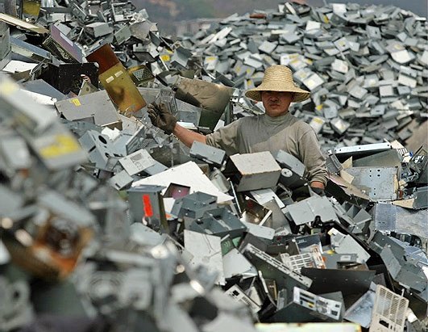
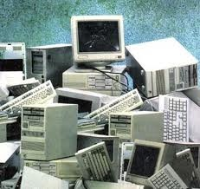
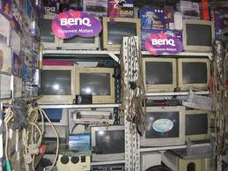
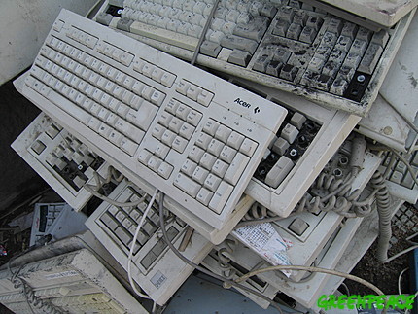
Computer wastes

